Slide 1
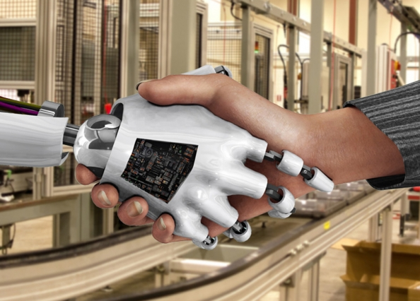
Human-Robot Interaction (HRI): Trust in Diagnostic Aiding Automation
Blake Nguyen and Na’Kiya Russell
University of Central Florida
October 30, 2018

Slide 2
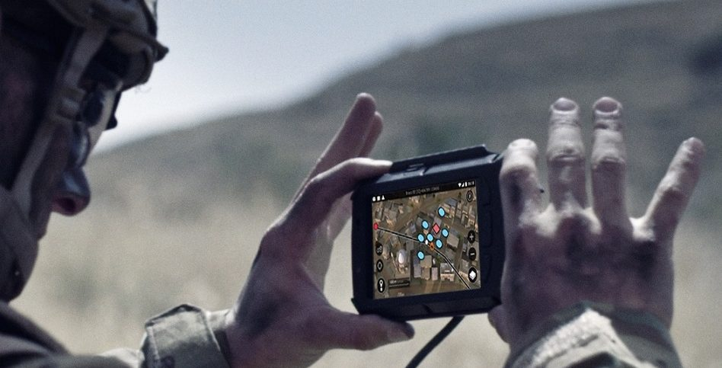

Human-Robot Interaction In HRI, the aspect of reliability is important to take into consideration when seeking research advancements in such complex teaming. Previous research regarding reliability refers to a reliability threshold. When diagnostic aiding technology falls below 70% reliability, it is seen as not useful, and will negatively affect overall task performance (Wickens & Dixon, 2007). The reliability threshold is based on tasks humans are capable of performing without needing help from such technologies.

Slide 3
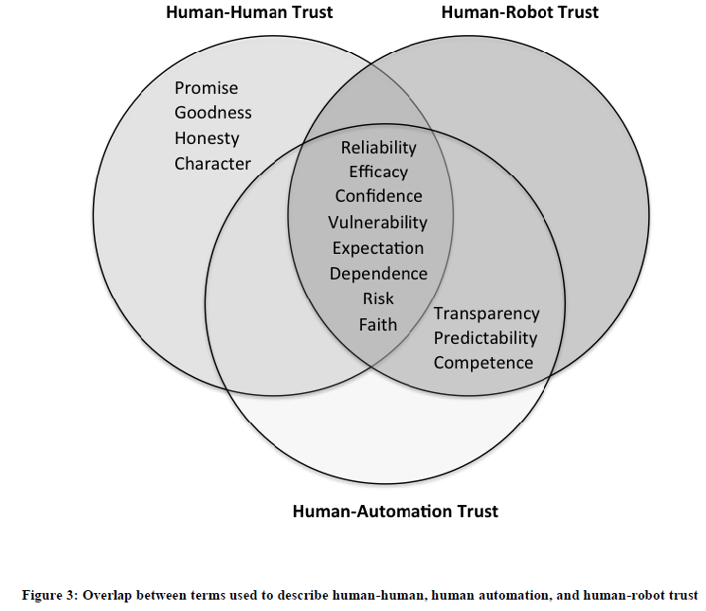
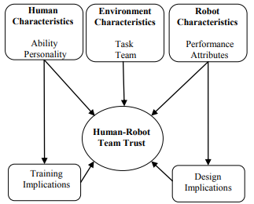
Trust and Human-Robot Interaction (HRI)
Trust plays an important role in HRI. Trust varies due to the characteristics of the trustor and trustee. The characteristics that affect the trustor and trustee relationship: the situation, the environment, and the task. Differences amongst these relationships occur when it is remembered machines are designed.

Slide 4
Previous Research on Trust
In previous studies, trust is place onto a thing or a person, it sometimes makes it hard to properly define trust and apply it appropriately. Sandra (2016) stated that “trust varies due to characteristics of both the trustor and trustee. The characteristics that can affect these two entities are: the situation, the environment, and the task. There is a clear distinction made by Sandra (2016) that “reliable is appropriate to describe both human-human and human-robot interactions, terms like good and honest do not necessarily apply the HRI domain.”

Slide 5
Reliability and Human-Robot Interaction (HRI)
Wickens and Dixon (2007) identified this concept of a reliability threshold of 70%, which was based on their review of studies in which automation performed tasks which humans could perform unaided. In these types of tasks, if reliability falls too low, automation may be perceived as useless, or worse, may negatively affect overall task performance. As a result, human operators are less likely or less willing to rely on automated systems, and instead, execute tasks themselves while disregarding any information coming from an automated system that is perceived as unreliable. Madhavan, Wiegmann, & Lacson (2006), also identified that when automation reliability levels fall below the 70% threshold, performance tends to decrease to levels lower than those of manual task performance alone (i.e., unaided by automation).

Slide 6
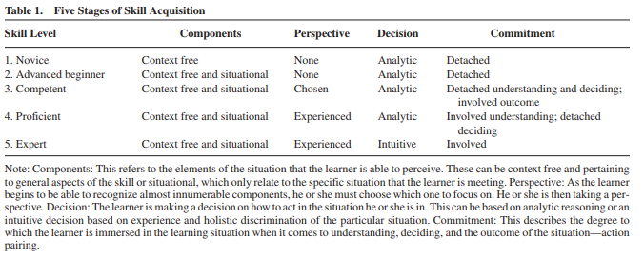
Defining Novice and Experts
When defining a novice and an expert there are several variables that must be considered when determine their difference. Dreyus & Dreyus (1986) described a theoretical framework of the Skill Acquisition Model (SAM). This model allows researcher to document the development of performers as they develop their skills and progress from stage to stage.The skill learning theory contains five stages of skill development: Novice, Advanced Beginner, Competent, Proficient, and Expert.

Slide 7
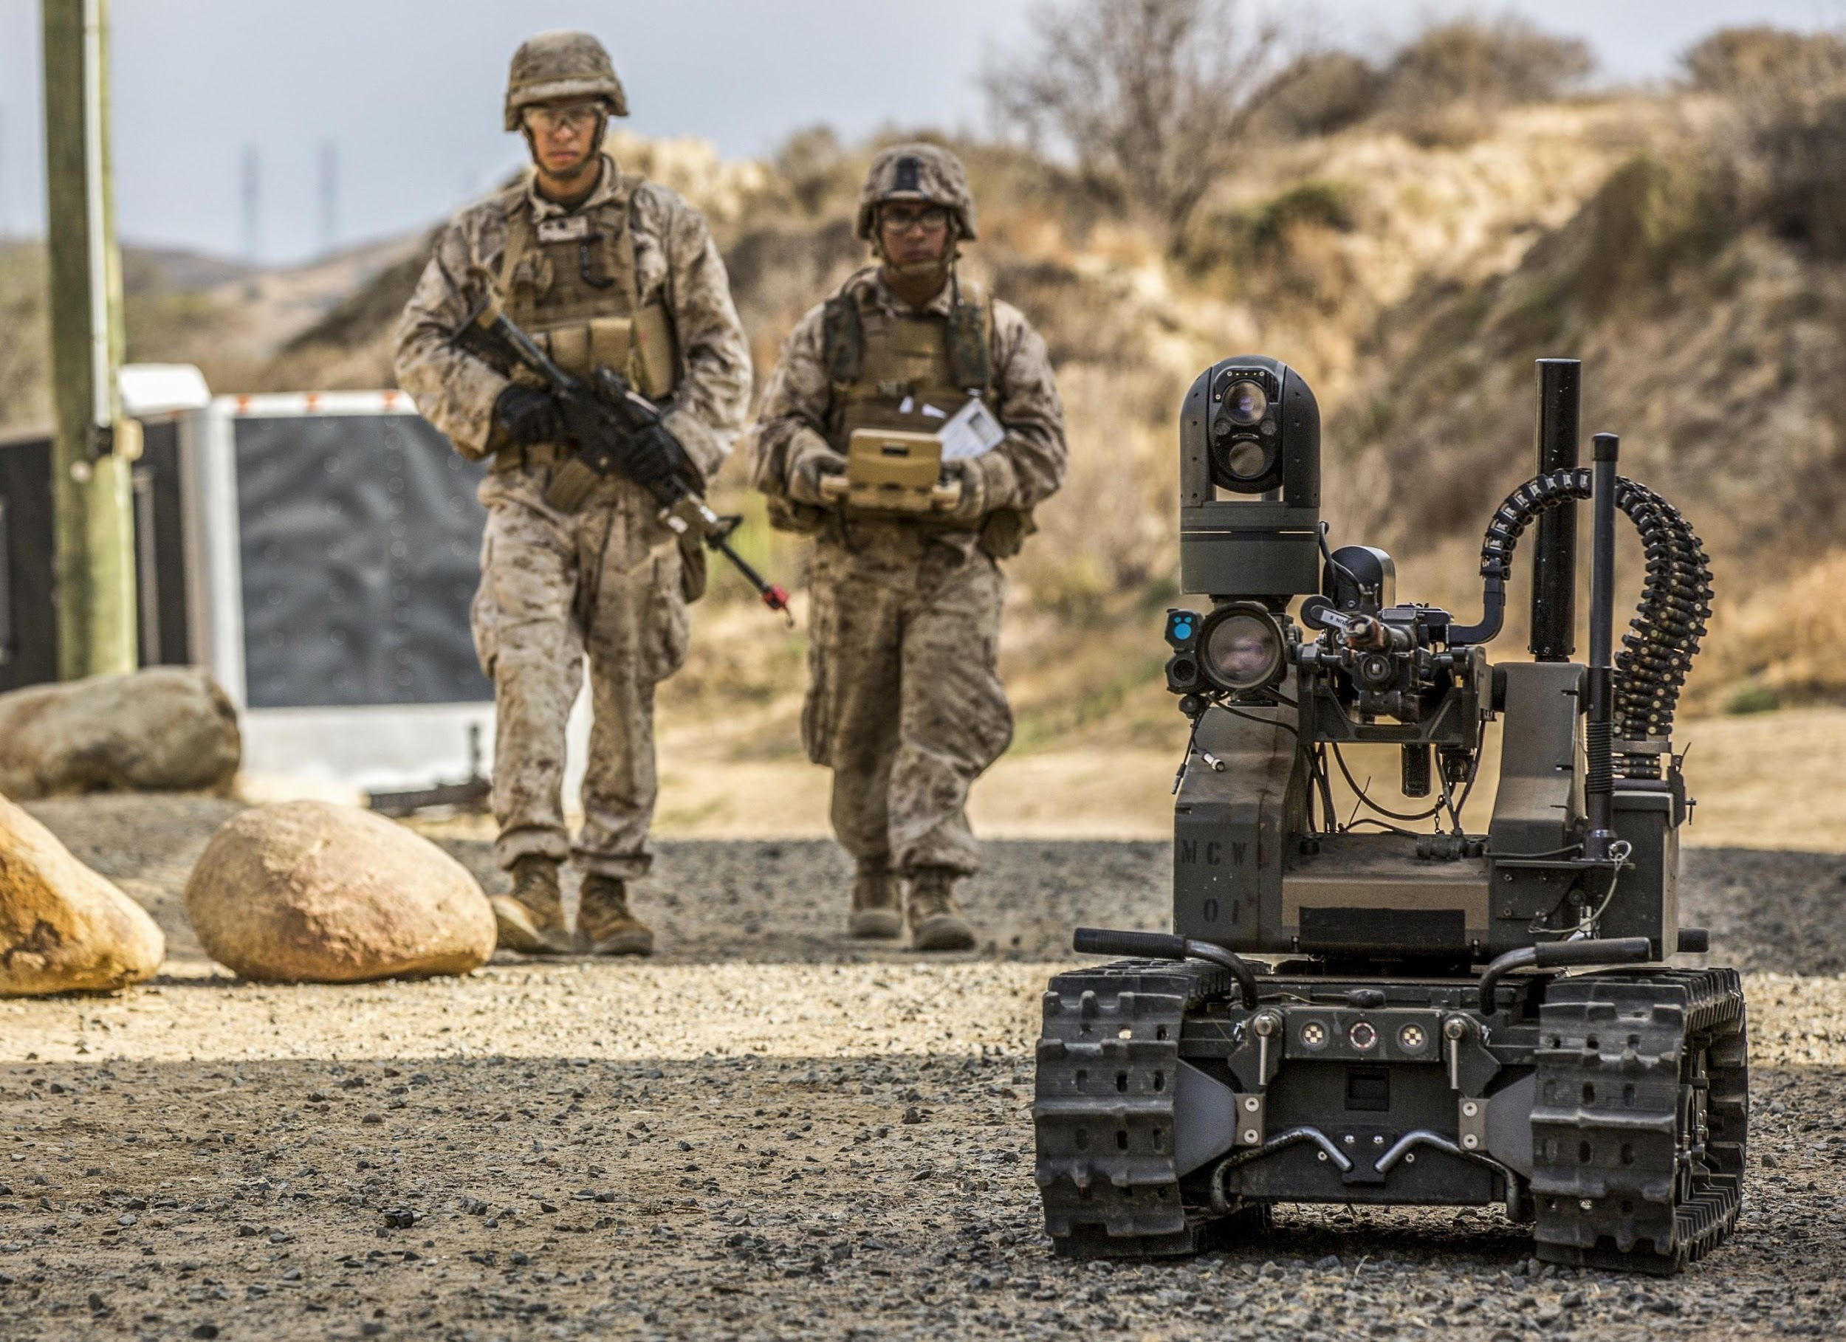
Purpose Statement
The purpose of this study is to explore the reliability threshold and its effects on HRI in various environmental conditions.
This study is also interested in determining whether or not levels of expertise (novice and experts) plays a factor in the willingness to trust or rely on diagnostic aiding automation in safe and dangerous environmental conditions.

Slide 8
Research Questions
Is there a difference in perception of reliable and unreliable diagnostic aiding automation in both safe and dangerous environments when comparing levels of expertise (novice and experts)?
Do novice consider diagnostic aiding automation to be reliable or unreliable as opposed to an expert operator when automation reliability rate is set to 50% in both benign and hostile environments?

Slide 9
Hypotheses
H₁: It is hypothesized that novice participants in the 50% reliability condition will have lower levels of trust in an autonomous robot than expert participants.
H₂: It is hypothesized that novice participants in both the safe and dangerous environments will have lower levels of trust in an autonomous robot than expert participants.
H₃: It is hypothesized that expert participants in the 50% reliability condition and safe environment will have lower levels of trust in an autonomous robot similar to novice participants.
H₄: It is hypothesized that expert participants in the 50% reliability condition and dangerous environment will have higher levels of trust in an autonomous robot dissimilar to novice participants.

Slide 10
Methods

Slide 11
Study Design
 | Safe Environment | Dangerous Environment
Novice | Novice Safe Environment | Novice Dangerous Environment
Expert | Expert Safe Environment | Expert Dangerous Environment
*Level of reliability is not part of the design because its kept constant at 50%.

Slide 12

Study Design Information
Independent variables: Environmental conditions - safe and dangerous
Quasi Independent variable: Level of Expertise (Novice and Experts), this variable cannot be randomly assigned and is an innate characteristic of the participants involved.
Dependent variables: Participants’ level of trust on robot’s feedback; revised questionnaire from existing literature.
Subjective Ratings of Autonomous Robots (S-RAR) questionnaire: asks participants to rate robot on nine traits using a 6-point semantic differential scale. Example of bipolar adjectives includes: unreliable/reliable, untrustworthy/trustworthy, and etc. Participants were then asked to choose three scenarios, in which they believed humans working with aid from a robot would be more effective than humans working alone.
Notes:
Quasi-experiments are employed when the researcher is interested in independent variables that cannot be randomly assigned. Usually this happens when the independent variable in question is something that is an innate characteristic of the participants involved

Slide 13
Study Process
Participants involved in this study will have to be students who are enrolled at the University of Central Florida through the (UCF) SONA Systems.
Pre-screening measure will screen students for age and gender such that only students who are 18 years or older are able to sign up to participate in our study.
We are interested in collecting 90 participants for our study.
Participants will be presented with the following materials:
Informed consent
Demographics questionnaire
Stimuli which includes reading materials and describing the purpose, capabilities, reliability, and operational environments of a fictitious robotic teammate.
Revised questionnaire to better assess whether levels of expertise find automation reliable or unreliable.
S-RAR questionnaire
Post-Participation Information Form

Slide 14
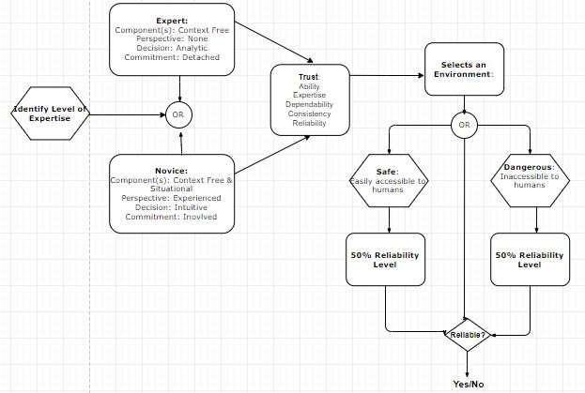
Model

Slide 15
Results - Data Analysis
Statistical Approach: To analyze the data collected from our research study, we will be utilizing Multivariate Analysis of Variance (MANOVA). MANOVA is useful and pertains to our research study because we looking at different dependent variables such as safe and dangerous environmental conditions, novice participants, and expert participants, all on the independent variable of fifty percent reliability. With the data gathered from our Qualtrics online survey, MANOVA testing can be carried out by using Statistical Package for the Social Sciences (SPSS) Statistics. SPSS Statistics is a powerful tool for manipulating and deciphering survey data.

Slide 16
Completed Plan of Action
Determined the definitions of novice and experts based on literature review on levels of expertise.
Revised stimuli, which includes reading materials and describing the purpose, capabilities, reliability, and operational environments of a fictitious robotic teammate.
Revised questionnaire to better assess whether levels of expertise find automation reliable or unreliable.
Implemented questionnaire into Qualtrics online survey
Developed UCF IRB submission with related study materials such as:
UCF IRB Submission
irb_HRP-503 - Protocol
irb_HRP-502 - Informed Consent
irb_HRP-509 - Explanation of Research
Post-Participation Information Form
Completed final draft readme file/paper on Github
Notes:
Blake

Slide 17
Future Plan of Action
Before submitting our UCF IRB protocol we need to address these administrative tasks:
Ensure that all personnel involved in data collection have the appropriate training:
CITI training
IRIS account
SONA researcher account
Submit UCF IRB protocol and related materials (informed consent, post-participation information form, stimuli, etc.)
Train all staff to run data collection for our study
Submit SONA ad to gain access to SONA timeslots
Complete data collection for the next two semesters
Complete data analysis
Draft results based on data analysis
Submit paper to HFES conference
Notes:
Na’Kiya

Slide 18
References
Image References:
http://news.mit.edu/2013/humans-robots-interaction-cross-training-0211
https://github.com/krman009/Octodex-Images-Links
https://www.google.com/search?tbm=isch&q=github+kitty&chips=q:github+kitty,g_1:octocat&usg=AI4_-kQqGakIm54gESFuomELJt-9IyMmgg&sa=X&ved=0ahUKEwilxe_x-azeAhUwh-AKHWtaBAYQ4lYIKygB&biw=1169&bih=647&dpr=2#imgrc=jwqWNATuXr5CbM:
Faerevaag, C. L., Nguyen, B. A., Jimenez, C. A., Jentsch, F. (2017). Attitudes toward unreliable diagnostic aiding in dangerous task environments. In Proceedings of the Annual Meeting of the Human Factors and Ergonomics Society (Vol. 61). Los Angeles, CA: SAGE Publications.
Dreyfus, S. E. (2004). The Five-Stage Model of Adult Skill Acquisition. Bulletin of Science, Technology & Society,24(3), 177-181. doi:10.1177/0270467604264992.
Madhavan, P., Wiegmann, D. A., & Lacson, F. C. (2006). Automation failures on tasks easily performed by operators undermine trust in automated aids. Human Factors, 48(2), 241-256.
Wickens, C. D., & Dixon, S. R. (2007). The benefits of imperfect diagnostic automation: A synthesis of the literature. Theoretical Issues in Ergonomics Science, 8(3), 201-212.

